Slide 1
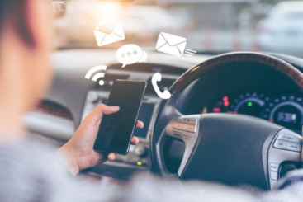
Distracted Driver Detection
By:
Zamzam Alsarayrah
Ganesh Morye
Rahul Mukerjee
Data Scientist
General Assembly

Slide 2

Introduction:
People are often multi-tasking while driving
Most common activities during driving are talking on phone, texting, eating, applying makeup
These “distractions” make the driver less attentive and compromise the safety of the driver, passengers, bystanders, and others
The United States Department of Transportation states that one in five car accidents are caused by distracted drivers, meaning that distracted driving causes injuries to 425,000 people and claims the lives of 3000 others every year¹.
State Farm is a nationwide insurance company that help people manage the risks of everyday life, recover from the unexpected, and realize their dreams.
State Farm released this dataset as a Kaggle challenge to test whether dashboard cameras can automatically detect drivers engaging in distracted behaviors to better insure their customers

Slide 3
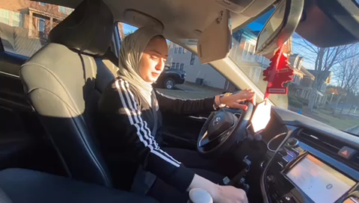


Slide 4
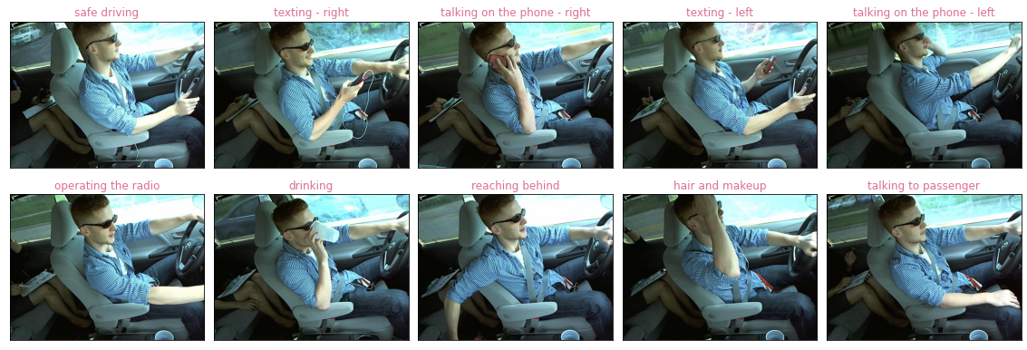

Problem statement :
To predict the likelihood of what the driver is doing in each picture by classifying the images in one of the following 10 classes.
Dataset for this project was downloaded from Kaggle and predictions were uploaded to score the models. The models are scored on LogLoss metric

Slide 5
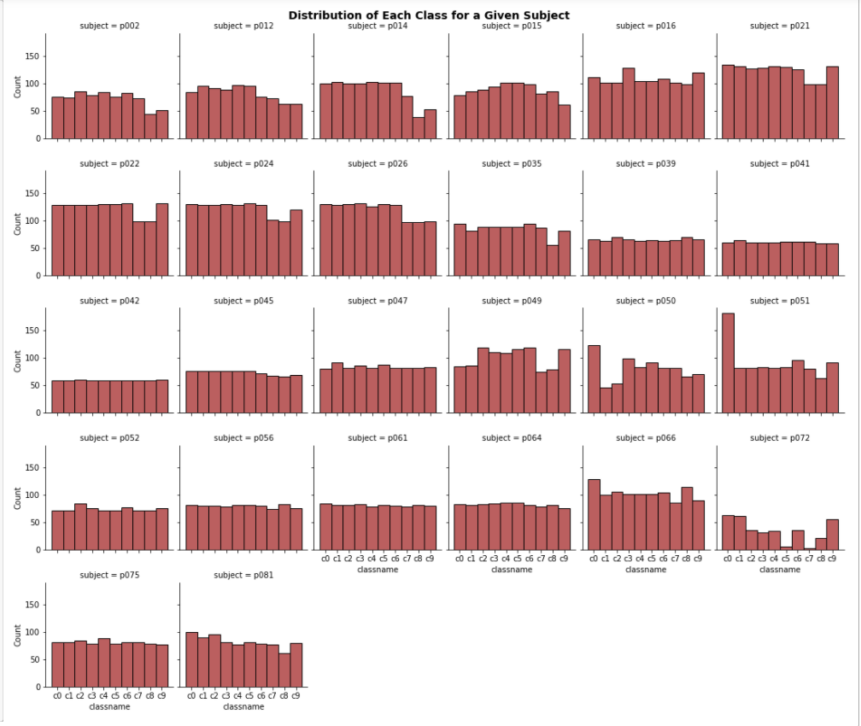
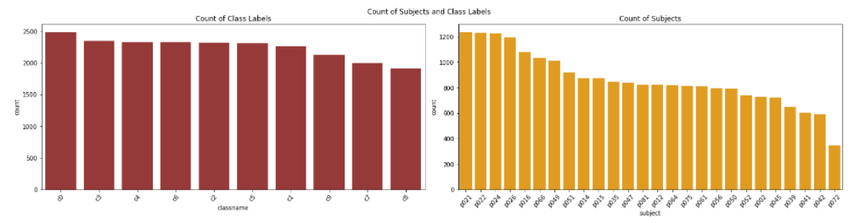
dataset / Exploratory Visualization
TRAINING DATASET: 22k Images of 26 subjects
TESTING DATASET: 79k Images
Subjects appear in either the training or testing dataset but not in both
Labels are evenly distributed
Image count of subjects widely varies

Slide 6
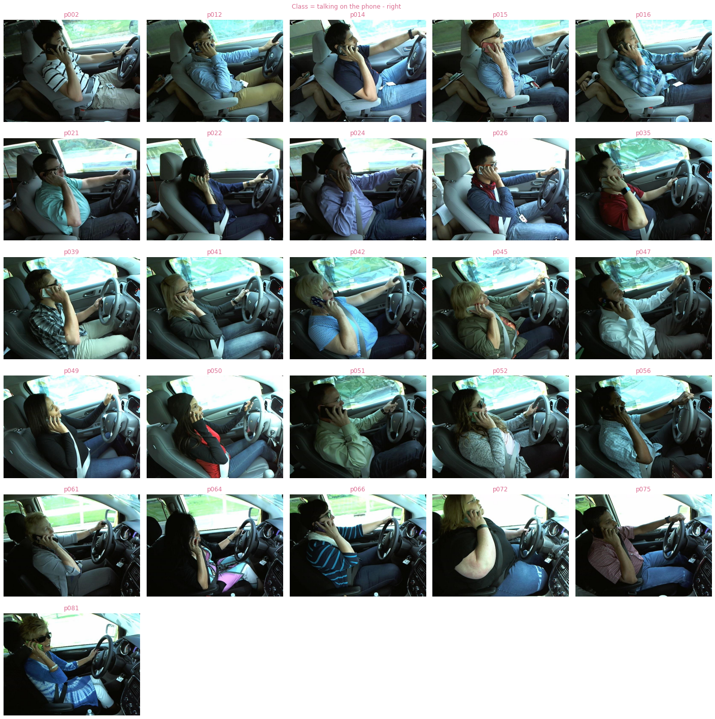
All the 26 subjects in the training dataset

Slide 7
methods and models:
Convolutional Neural Networks(CNN)
Image Data Generator
Neural Network
pre-trained VGG16 & VGG19
pre-trained EfficientNetB0

Slide 8
Base Model structure :
Our base model is a simple CNN model :
1- we use 2 CNN layers:
a- layer 1 with 50 filters, (3,3) kernel size.
b- layer 2 with 16 filters, (3,3) kernel size and relu activation function.
2- after that we use 2 MaxPooling with (2,2) pool size.
3- two Dense layers, the first one with 128 neurons and the second one with 64 neurons, both use Relu activation function.
4- Output layer with 10 neurons and softmax activation function.
5- Two Base models are generated
Regular train_test_split
GroupKFold train_test_split.

Slide 9
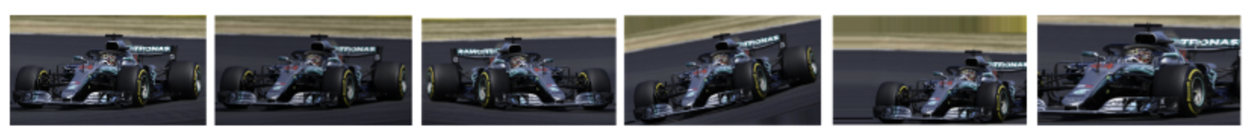
IMAGE DATAGENERATOR
Image augmentation is a technique to expand your dataset and add variations to the images which are not captured in the original dataset
Apply random transformations like rotation, shear, horizontal and vertical offsets etc., to the original train images
Results in multiple transformed copies of the same image
Variations in the dataset allows the model to generalize better and it becomes more robust

Slide 10
Pre-Trained Models
What is a Pre-trained Model?
A pre-trained model is a model created by some one else to solve a similar problem. We use this model as a starting point.
Why use Pre-trained Models?
To “transfer” the learning from the pre-trained model to our model to avoid having to train our model from scratch
How to use a Pre-trained Models?
Define the objective of our problem to identify the class of pre-trained models to use
Use a pre-trained model which was trained for a similar problem. For e.g., Image classification pre-trained model for an Image classification problem.

Slide 11
Transfer LEARNING
Using a pre-trained model to our specific problem is called Transfer Learning
Use of pre-trained models takes 3 different forms:
Feature Extraction:- Directly use the weights and architecture and apply that learning to our problem. The only modification that would be required in this case is changing the output layer depending on our class labels
Transfer Learning:- Use the weights and architecture of the convolutional layers and train the user-defined FNN layers
Fine-tuning:- Tweak the already trained convolutional layers and train the model.

Slide 12
Pre-trained models used in the study
All the pre-trained models used in the study were trained on the imagenet dataset of more than 1 million images in 1000 different classes
VGG16
developed at university of oxford
16 layers and 138,423,208 million trainable parameters
VGG19
Like vgg16 with 19 layers and 143,667,240 trainable parameters
EFFICIENTNETBO
Developed by Google
8 alternative implementations (b0 to b7)
5.3 million trainable parameters

Slide 13
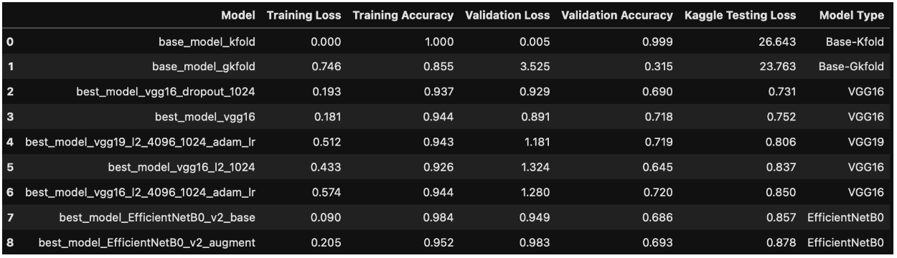
Modeling Results
1st model is the base model with random train_test_split gave accuracy of 1 for both training and validation but a testing loss of 26.64
2nd model is the base model with Group Kfold train test split reduced the validation accuracy to 30% and improved the testing loss to 23.7
Our best model performance with pre-trained model was for VGG16 model with a single hidden layer of 1024 nodes. The testing loss was 0.73

Slide 14
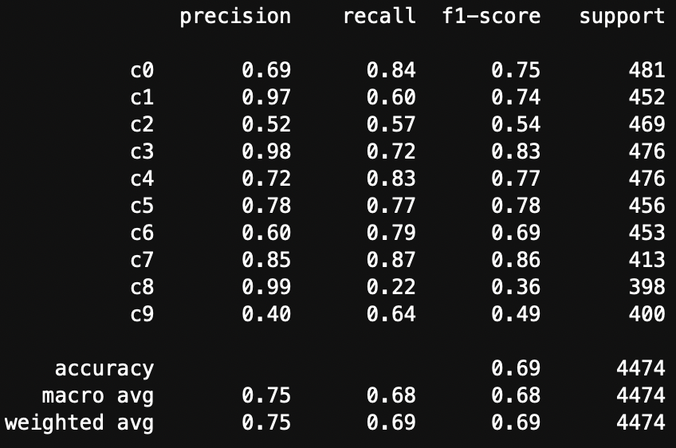
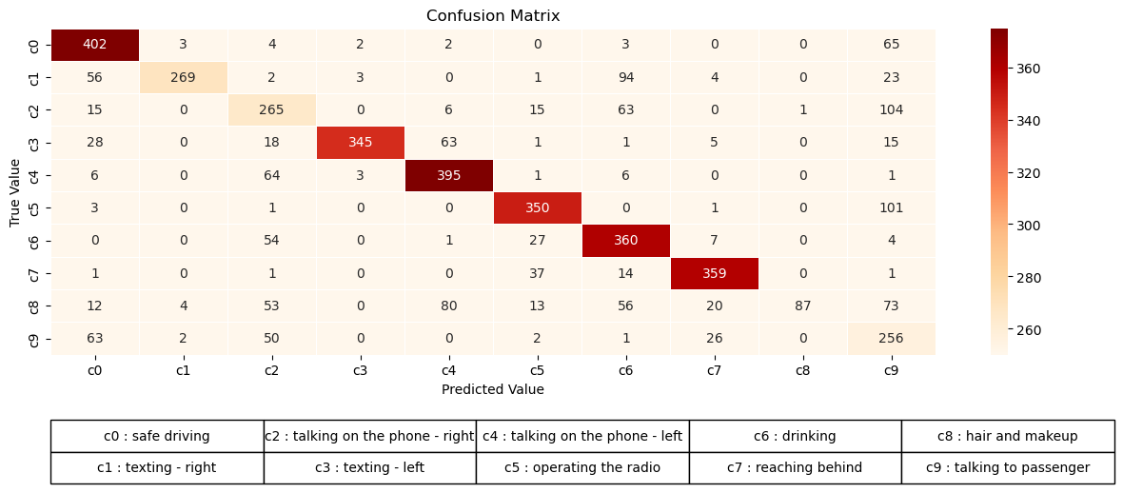
Classification Report and Confusion Matrix
Class labels c8 and c9 have the lowest f1-score and c3 and c7 have the highest

Slide 15
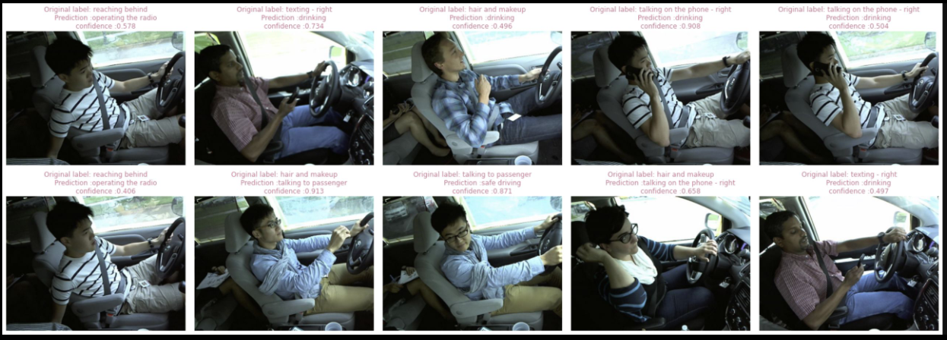
Mislabeled Prediction Analysis

Slide 16

Use of pre-trained models significantly improved the predictions of the CNN model
A CNN model using a VGG16 pre-trained model gave testing loss on Kaggle of 0.73
Model performance along with ImageAugmentation did not offer any noticeable improvement in the scores
Fine tuning of the convolutional layers was not attempted which could have led to better scores

Slide 17
